Slide 1
History of the Indian Constitution

Slide 2

History of the Indian Constitution
From Colonial Legacy to the World’s Longest Written Constitution
Course: Computer Engineering (CE–B) — Presented by Chanpura Keyur D., Chanpura Shivam M., Maheriya Hardik S., Wadhvana Shyam B.
Subject:Indian Constitution

Slide 3

Introduction
The Indian Constitution is the supreme law of India.
It provides the framework for governance, fundamental rights, and duties.
Adopted on 26 November 1949, and came into effect on 26 January 1950.
It made India a sovereign, socialist, secular, and democratic republic.

Slide 4
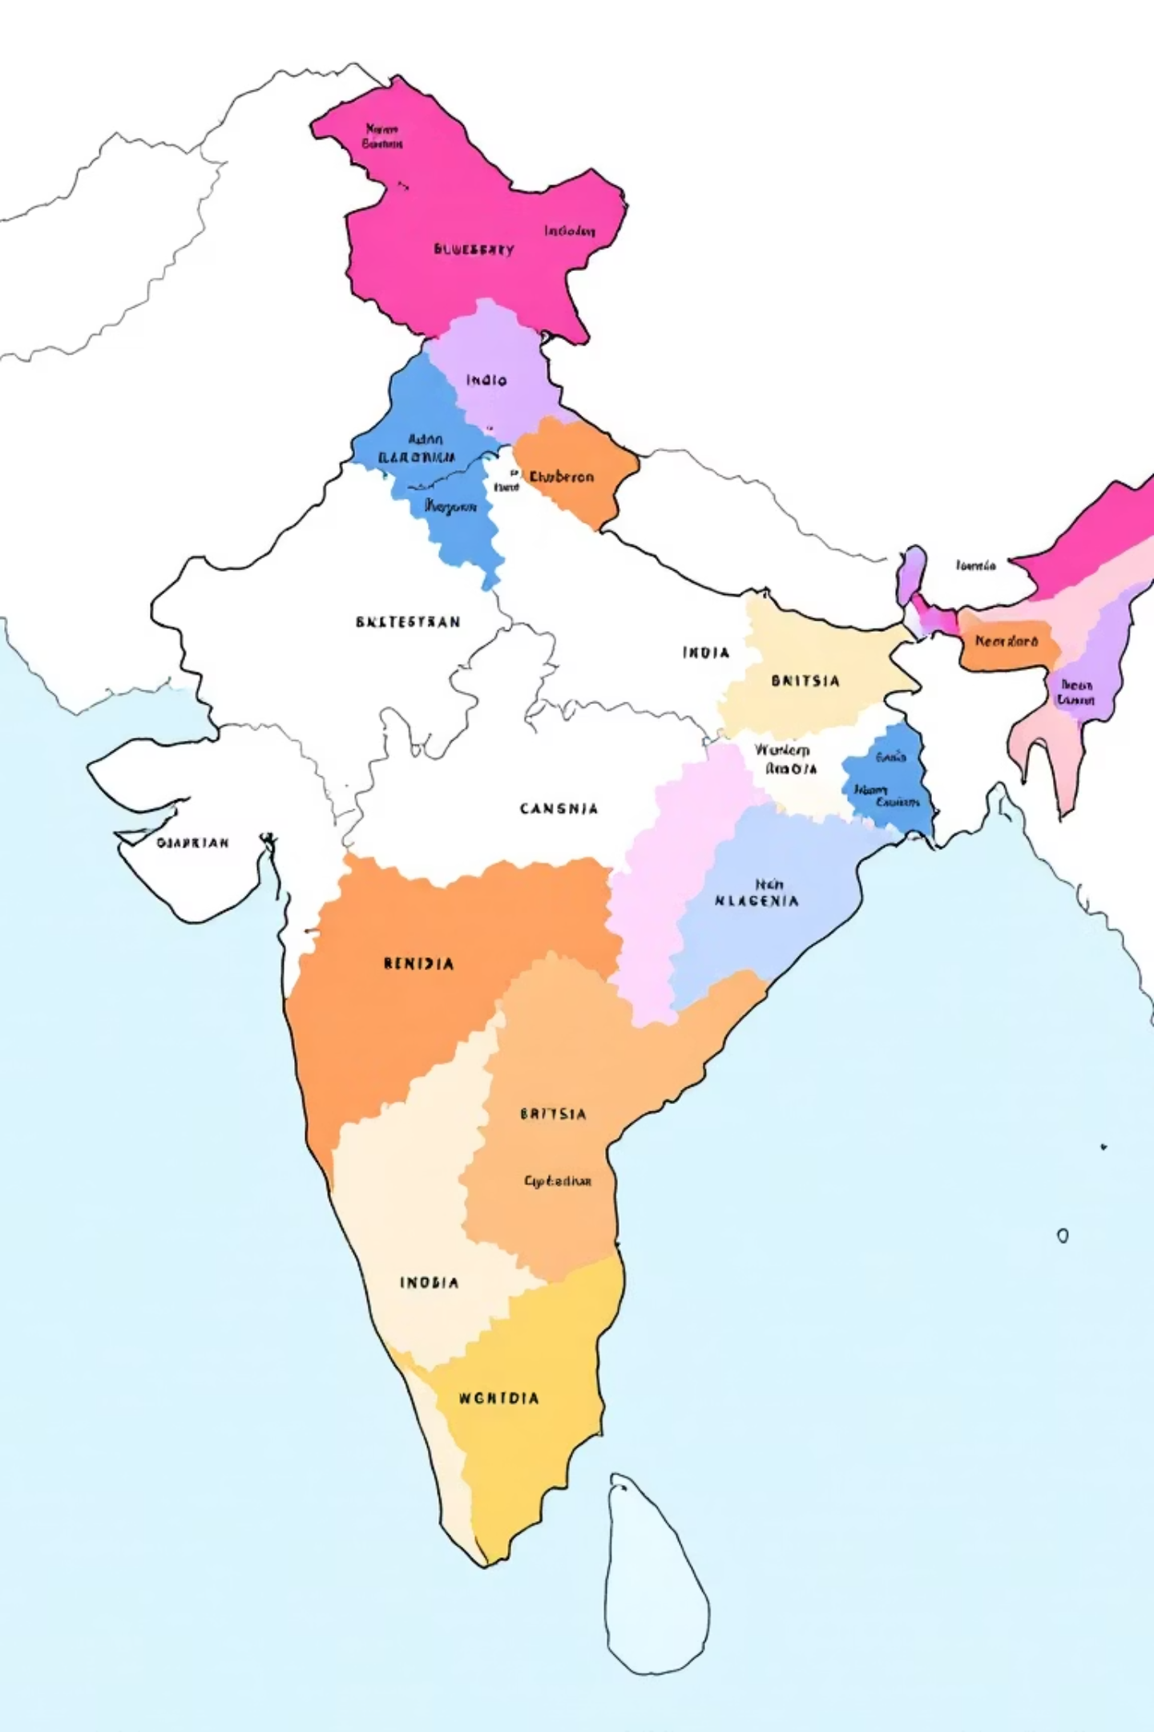
Historical Background
India was under British colonial rule for almost 200 years.
Various acts and reforms laid the foundation for constitutional development:
Regulating Act, 1773
Charter Acts (1833, 1853)
Indian Councils Acts (1861, 1892)
Government of India Acts (1909, 1919, 1935)
These acts gradually introduced representative government in India.

Slide 5
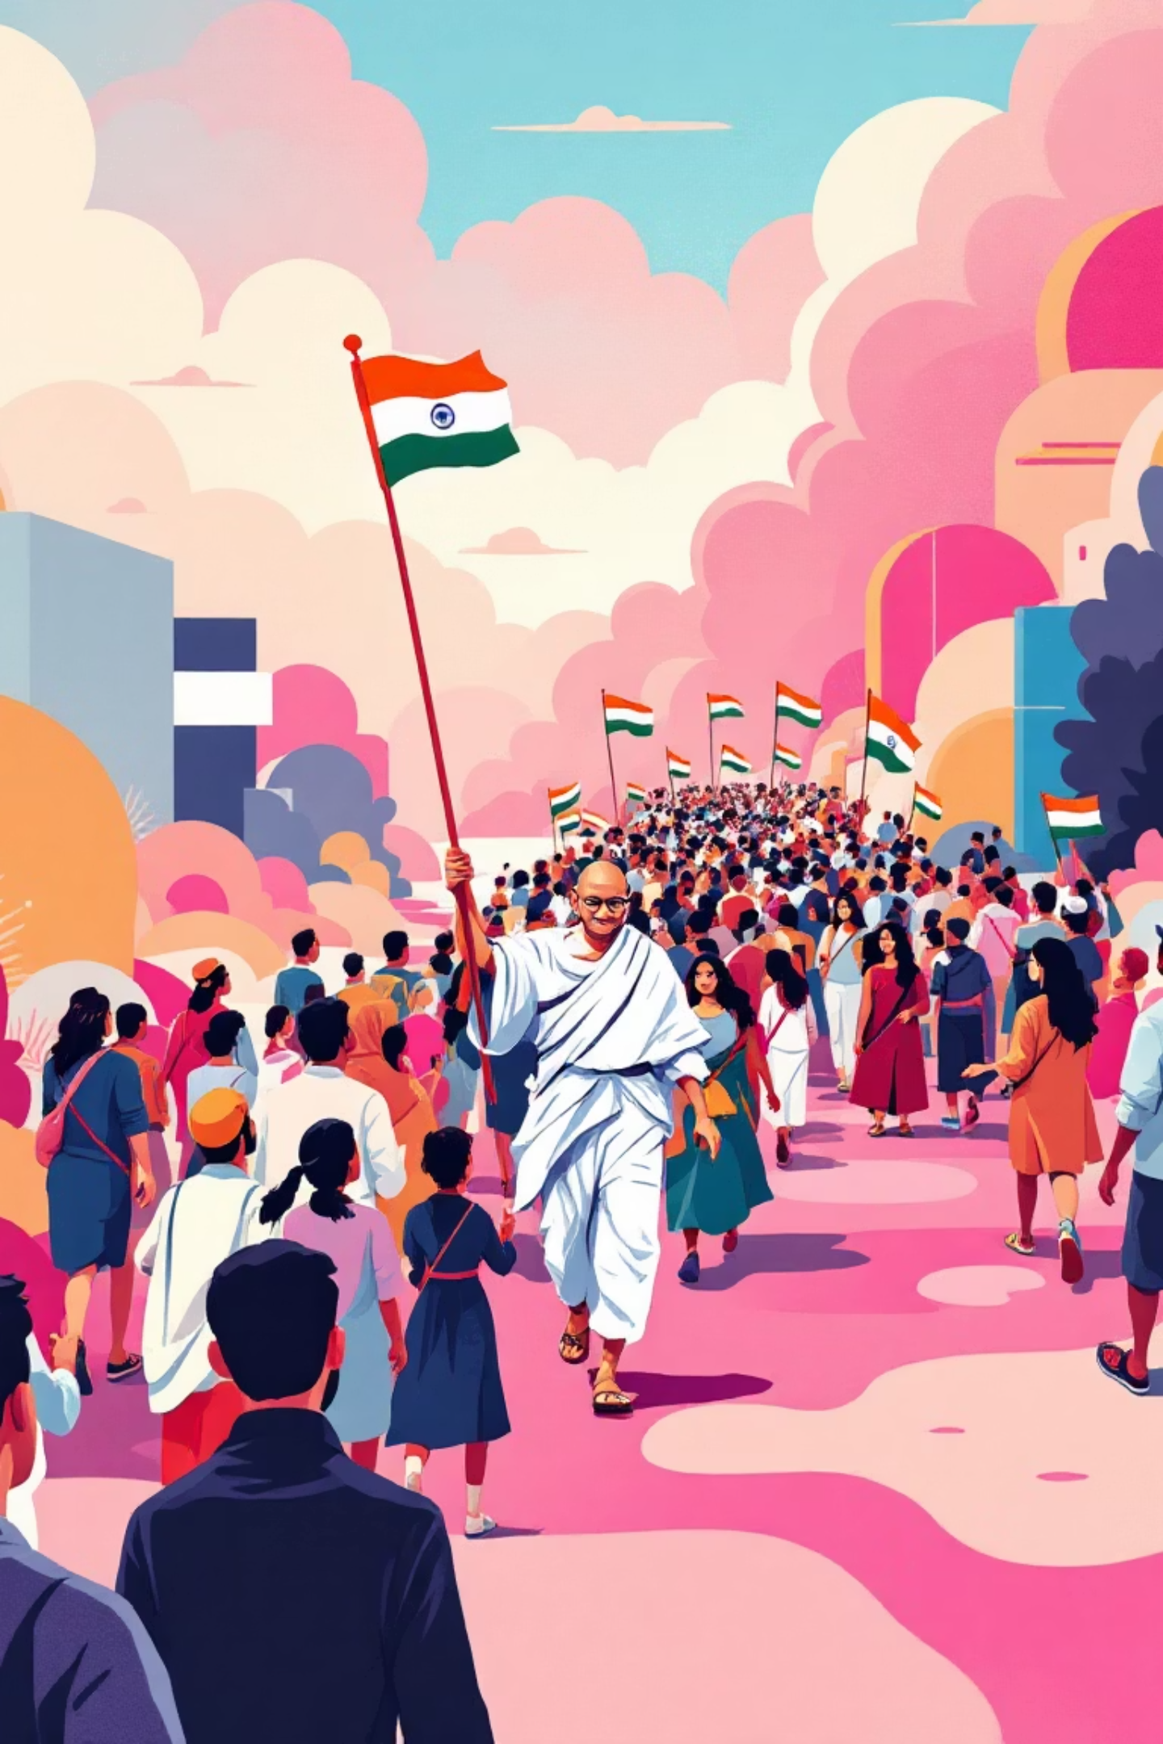
Demand for a Constitution
The demand for a constitution grew with the Indian National Movement.
Swaraj (Self-rule) became a key goal of the Indian National Congress.
Nehru Report (1928) – first attempt by Indians to draft a constitutional framework.
1946 Cabinet Mission Plan proposed the formation of a Constituent Assembly.

Slide 6
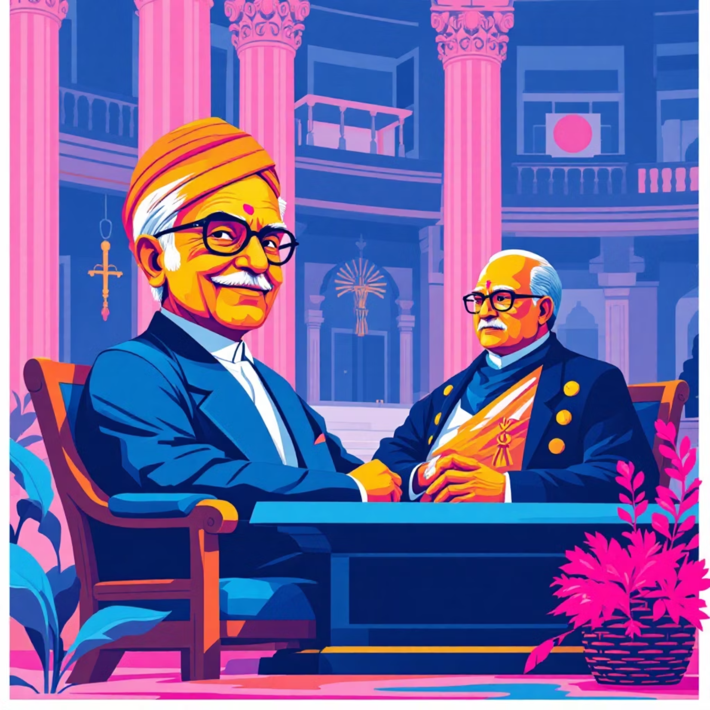
Constituent Assembly Formation
Formed in December 1946 under the Cabinet Mission Plan.
389 members (later 299 after Partition).
Dr. Rajendra Prasad – President of the Assembly.
Dr. B.R. Ambedkar – Chairman of the Drafting Committee.
Included members like Jawaharlal Nehru, Sardar Patel, Maulana Azad, and others.

Slide 7
Drafting the Constitution
Drafting Committee formed
Draft completed
Total expenditure
on 29 August 1947.
in 2 years, 11 months, and 18 days.
₹64 lakh.
Constitution adopted
Enforced
on 26 November 1949.
on 26 January 1950 (chosen to honor the 1930 Purna Swaraj declaration).

Slide 8





Sources of the Constitution
Borrowed features from several countries:
UK
USA
Parliamentary system, rule of law.
Fundamental Rights, Judicial Review.
Ireland
Canada
Directive Principles of State Policy.
Federal structure with strong center.
Australia
USSR
Concurrent List, Freedom of Trade.
Fundamental Duties, Five-Year Plans.

Slide 9
Key Features of the Constitution
World’s longest written constitution
(395 Articles, 12 Schedules initially).
Federal structure
with unitary bias.
Parliamentary democracy
Fundamental Rights & Duties
Directive Principles of State Policy
Independent judiciary

Slide 10

Enforcement and Republic Day
Constitution came into force on 26 January 1950.
India became a Republic with Dr. Rajendra Prasad as the first President.
26 January is celebrated as Republic Day every year.

